Slide 1


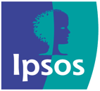
winning proposition optimiZation
Powered by Ipsos Vantis
© 2023 Ipsos. All rights reserved. Contains Ipsos' Confidential and Proprietary information and may not be disclosed or reproduced without the prior written consent of Ipsos.

Slide 2

GOOD RESEARCH SHOULD CAPTURE THE COMPLEXITY OF HOW PEOPLE MAKE CHOICES AND HOW THEY IMPACT YOUR BUSINESS
© Ipsos

Slide 3

Choice models are a powerful and realistic way to Uncover new opportunities to grow your business
Business model optimization
Find the right path to monetize your offer – subscription, one-time fee, plans etc. Should you monetize the app or the durable?
Portfolio optimization
Find the right mix of products, prices and even simulate various market conditions to respond effectively to competition
Product optimization
Do you have to offer an app or a smart device? Define the ideal product/offer among many possibilities of price, features, varieties & designs.

Slide 4

But not all choice models are created equal
Ipsos is continually refining and calibrating its innovation choice models to provide the most accurate guidance available. We do this by leveraging our 35+ years of experience partnering with manufacturers outside of packaged goods, and by mining our unique database of 39,000+ non-CPG innovations – the largest of its kind.
Services
Tech
Durables
© Ipsos

Slide 5
By accounting for how people truly make decisions, we ensure your learnings translate into actual behavior
Models are built from the ground up to follow the consumer decision journey for your category – not a force fit into an existing model.
Ipsos models have the flexibility to accommodate many types of innovation requiring different consumer behaviors or decisions instead of repurposing CPG models.
Our models can accommodate new-to-the-word or far-out innovations requiring new behavior or extra education so you can move into new spaces with confidence.
We deliver accurate assessments of size of prize and opportunity in a collaborative and transparent way – not a black box

Slide 6

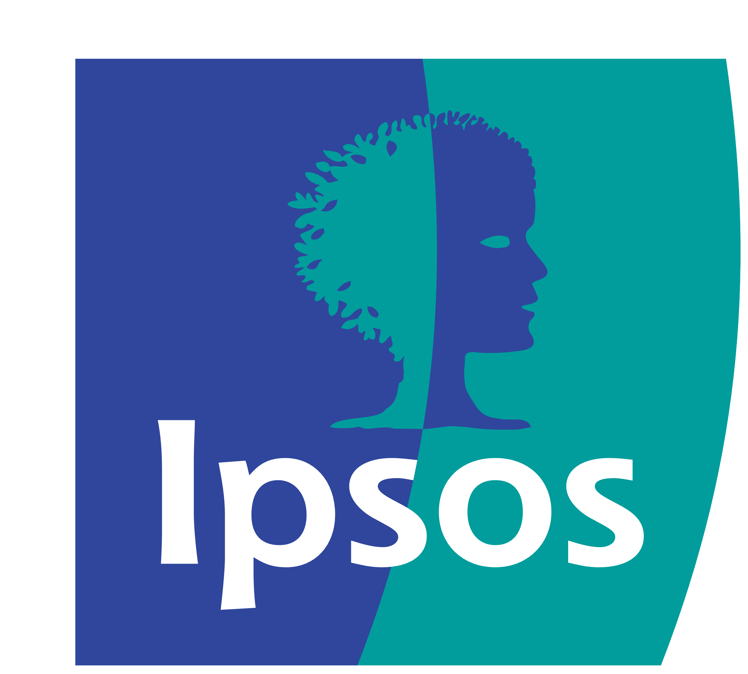
THE IPSOS DIFFERENCE:
INDUSTRY-LEADING ANALYTICS
Our experts custom design each project to your specific needs using a suite of unique and proprietary modeling techniques.
© Ipsos

Slide 7
Based on your actual business need, the proper type of choice model is selected – no force fits required!
Using the right approach leads to more successful innovation decisions
Fully-configured products and fixed bundles
Fragmented categories and products with pre-defined decision criteria
Services that allow you to customize your own basket or product
CHOICE MODEL APPROACH
Choice Based Conjoint | Adaptive Choice Based Conjoint | Menu-based Conjoint
KEY ADVANTAGES
VERSATILE Applicable for product, business model, or portfolio optimization. Simple design, may include varieties such as colors, sizes, etc. | INTUITIVE Follows consumer decision process and shows relevant alternatives. Ideal for evaluation in competitive context. | REALISTIC Replicates the real-life decision by allowing people to customize their basket or product. Ideal for a la carte offers.

Slide 8
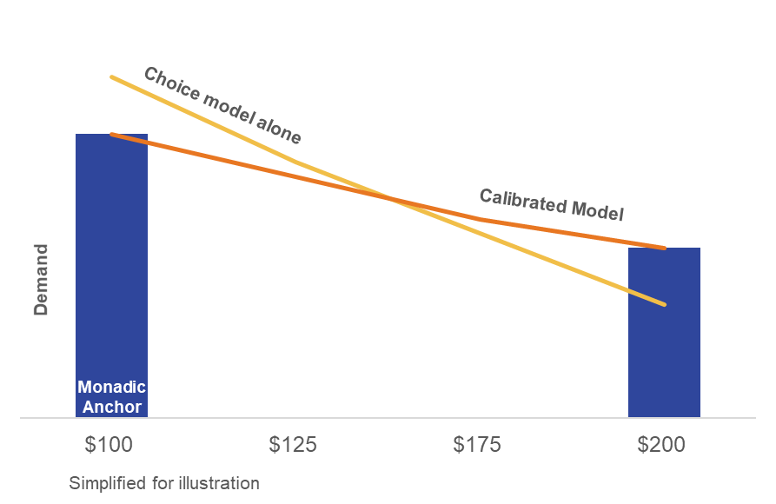

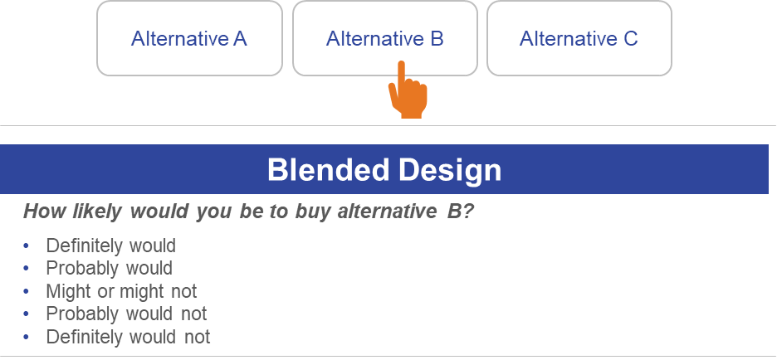
Ipsos models are enhanced to prevent common pitfalls seen in one-size-fits-all approaches
Proper expertise is required to ensure research results are accurate and actionable
01
Bridge the say-do gap
02
Stop unrealistic forced choice
03
Go beyond ‘willingness to try’
Validated Ipsos forecasting models are used to accurately calibrate overstated preference and price sensitivity in choice models. This closes the gap between what respondents say in a survey and what they will do in reality.
A unique blend of choice and scaled response is used to drive better discrimination and model accuracy. This corrects for people who choose an option simply because they feel compelled to do so, when the real answer is “none of these.”
Impact of friction points along the decision journey is accounted for in our model, since adoption goes beyond just willingness to try, i.e. compatibility with other products, budget, brand acceptance, timing etc. also influence choice.

Slide 9

THE IPSOS DIFFERENCE:
CONFIDENT BUSINESS DECISIONS
Learnings go beyond the obvious to uncover insights that will allow your business to truly succeed, including a full forecast and simulator – not just share of choice
© Ipsos

Slide 10
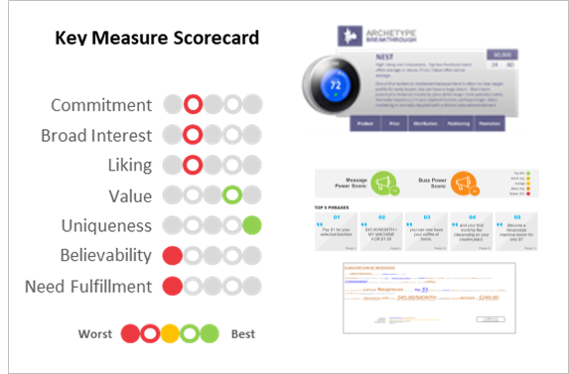
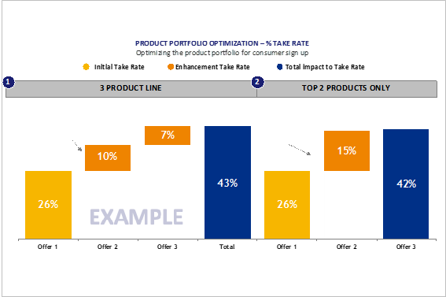
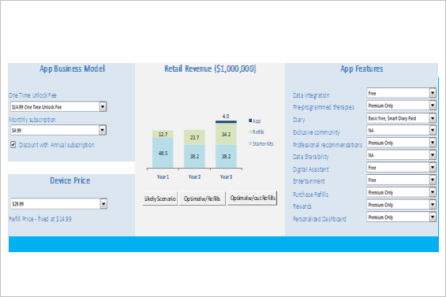
Every report is designed for strategic decision making
Assessment of Market Potential & Profile
Recommendations on Optimal Features & Pricing
Access to Powerful Interactive Simulator
Overall potential measured with validated benchmarking
Innovation profile revealed to ensure role in portfolio is aligned with to-go-to market strategy
Guidance on how to optimize messaging
Digestible and actionable summaries of which product scenarios will drive optimal adoption of your innovation (based on analysis of over 10,000 different unique product configurations)
Overview of which features truly matter and their relative impact on choice outside of price
Beyond a comprehensive report, you receive a simulator and a tutorial for running incremental simulations to further future proof the research as plans evolve
Predict sales based on multiple scenarios

Slide 11

Ipsos validated forecasts help you manage expectations
Over 120+ validated forecasts outside of CPG to date
Forecasting accuracy driven by 35 years of forecasting experience outside consumables, continuous validations, and choice model adjustments to reflect changing consumer behavior
80%
Actual sales within +/-20%

Slide 12
Forecasts are built into your own powerful simulator
You receive a full forecast including marketing assumptions – not just share of choice.
A custom-built interactive simulator helps you make decisions as you go. Understand the impact of every decision on business potential.

Slide 13

THE IPSOS DIFFERENCE:
BEST-IN-CLASS CLIENT SUPPORT
Your team of Ipsos experts is here to ensure you have exactly what you need, whenever you need it, no matter where in
the world you may be.
© Ipsos

Slide 14

You will have access to a dedicated team of client-centric experts at every step
Collaborative
Flexible
Customer-Focused
Innovative
We believe in a collaborative approach to innovation research. We bring our deep experience and toolkits to the table while maintaining an open dialogue with you to fully inform the research design and deliverables
Ideas and innovations come at different stages and in different shapes and sizes, so we ensure our approaches and designs are flexible enough to accommodate your specific business question and stage of development
Ipsos is GRIT’s #1 Most Innovative Company for 2 years running, meaning our teams bring award-winning thinking and analytics to every engagement so that your innovations are set up for in-market success
We focus on ensuring our methodologies accurately replicate how customers learn and make decisions in the real world, and are equally focused on your specific preferences when it comes to working style and outputs

Slide 15









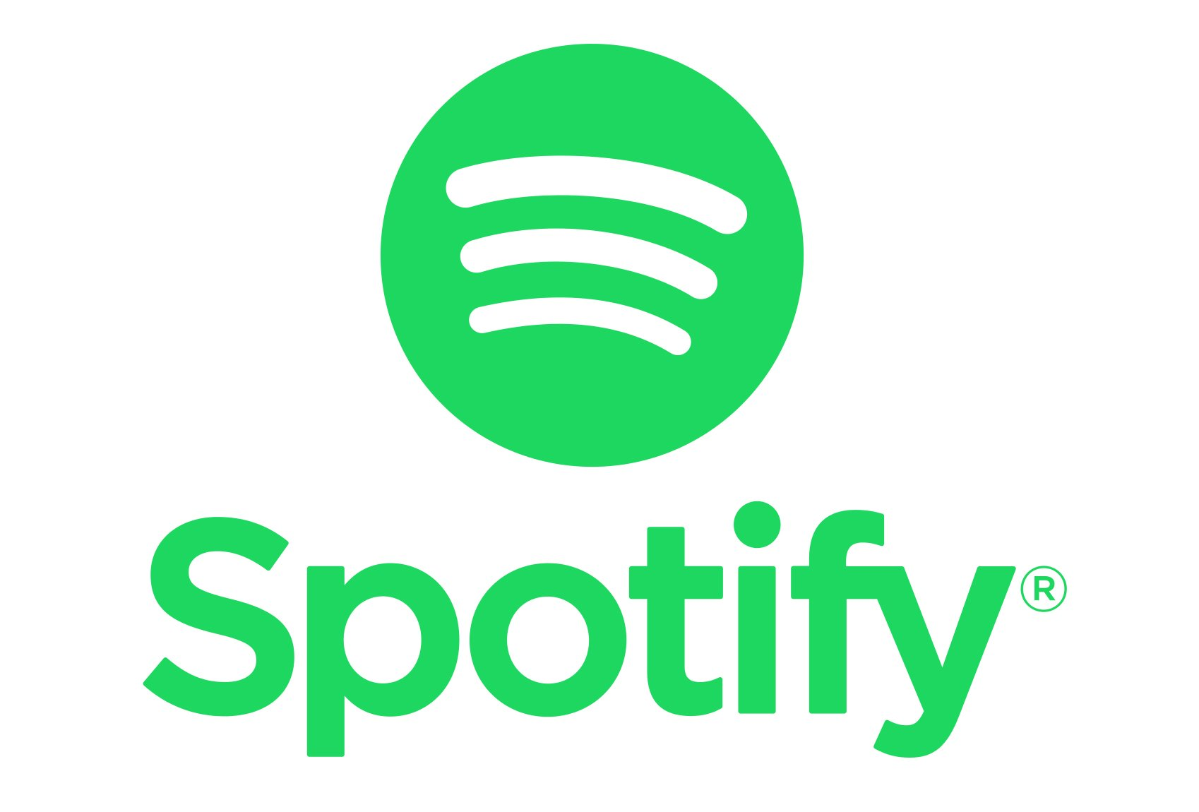













Our innovation experts are partnering with the biggest brands in service and technology today
These and other future-forward brands have leveraged Ipsos innovation frameworks and choice models to develop and launch some of the most successful innovations brought to market in recent years.

Slide 16
No matter where your innovation will ultimately live, our global coverage means we can assist
100+
Countries We Do
Research in
ALBANIA ALGERIA ARGENTINA AUSTRALIA BAHRAIN BELGIUM BOLIVIA BOSNIA BRAZIL BULGARIA CANADA CHILE CHINA COLOMBIA COSTA RICA CROATIA CYPRUS CZECH REP. DENMARK DOMINICAN REP. ECUADOR EGYPT FRANCE GERMANY GHANA GREECE GUATEMALA HONG KONG HUNGARY INDIA INDONESIA IRAQ IRELAND ITALY IVORY COAST JAPAN JORDAN KENYA KOSOVO KUWAIT LEBANON MACEDONIA MALAYSIA MEXICO MONTENEGRO MOROCCO MOZAMBIQUE NETHERLANDS NEW ZEALAND NIGERIA NORWAY PANAMA PAKISTAN PERU PHILIPPINES POLAND PORTUGAL PUERTO RICO QATAR ROMANIA RUSSIA SAUDI ARABIA SERBIA SINGAPORE SLOVAKIA SLOVENIA SOUTH AFRICA SOUTH KOREA SPAIN SWEDEN SWITZERLAND TAIWAN TANZANIA THAILAND TUNISIA TURKEY UAE UGANDA UK UKRAINE USA VENEZUELA VIETNAM ZAMBIA
89
Countries With
Ipsos Offices

Slide 17


Slide 18
APPENDIX: CLIENT CASE STUDIES
1

Slide 19

Successful partnerships that resulted in new (sub)categories
Robotic Home Devices
We have supported every new product launch for a category leader and have also helped them make some tough decisions, resulting in potentially substantial savings.
2%
Forecast model accuracy for this category has been as high as 2%.

Slide 20










Supporting the growth of robotic vacuums
The evolution of any one client’s go-to-market strategy can come in various shapes and sizes. This chart below represents how a close partnership between Ipsos and a leading Robotic Vacuum Company utilized strategic research to help bring new products to market, optimize their current line against competition and add volumetric context to understand true market potential before launch.
Assessing Close In Vs. Further Out Opportunities
Map out the landscape and identify opportunities
Forecast Validation
Applying volumetric modeling to one ore more new product entrants to validate sales potential
Innovation Benchmarking
Benchmark, size and refine opportunities
Conception
Pricing Strategy
Looking at an existing line to optimize the pricing structure and defend against competition and new entrants
Launch
Exploring Areas of Expansion
Understanding cleaning needs and how these mesh with other device connectivity in the broader smart home sphere
Testing Ideas
Prioritizing ideas to focus on in short term vs. long term
Product Optimization
Optimizing the first product of a new line to maximize sales, revenue and profitability
Portfolio Optimization
Understanding how a new suite of products should be built, priced and launched over a multi-year time frame
© Ipsos

Slide 21


Case – Product Optimization
Optimizing Use Cases Beyond Gaming
Going Beyond Rationale To Assess Emotional Impact
Finding the Right Combination of Experience & Features
Virtual Reality headsets have largely been associated with immersive gaming, but one client was interested in sizing usage opportunities beyond gaming. Ipsos worked closely with a copywriter and illustrator to create visual storyboards of new features including concerts, co-watching, co-gaming and live event immersions to help this client optimize how these new features could impact the price elasticity of their new VR device, incremental to other hardware improvements.
While standard optimization exercises often use just text, given this innovation needed visuals to drive home the benefits, hover overs were used in the DCM exercise to convey the value of each feature to consumers more accurately.
This approach is often recommended as a best practice by Ipsos for clients that have more experiential and emerging technology that is a challenge for consumers to truly understand unless they “see it.”
Our output simplified thousands of different product combinations, using our proprietary forecast model to reduce overstatement to drive adoption rates that are more reflective to in-market response.
Findings from this research led to a new hybrid product pathway the client wasn’t initially considering, merging several core capabilities already offered with 2 new experiences that drove higher adoption for VR beyond just gaming.

Slide 22

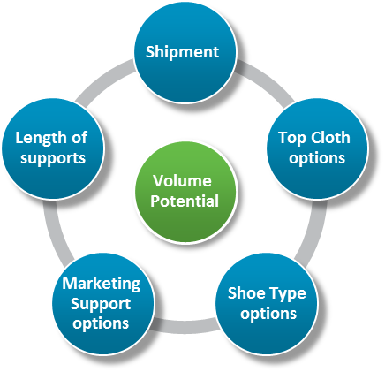
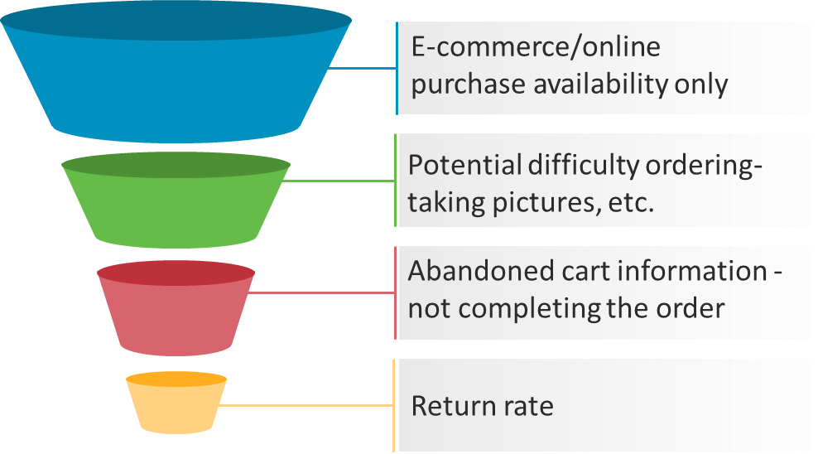
Case – Business Model Optimization
Adding a DTC Variant to an Existing Line
Identifying the Friction in the User Experience
Building the Offer
Our footcare client, a category leader wanted to partner with a tech company to grow their brand. They wanted to explore the potential of an app-based direct to consumer platform, which would allow people to measure their feet with the camera on their smartphone and order custom made 3D printed inserts right from their home. Key questions from the client were around overall potential of the proposition and impact on the existing line of retail products.
Leveraging our business model optimization, we were able to identify a sizable DTC business opportunity for our client with minimal interaction with the existing line. The client was able to make decisions on pricing, shipping options , premium upgrades and more based on the forecasted revenue with each decision.
We also provided clear consumer driven guidance on the appropriate channel - Amazon exclusive vs. independent website, giving our clients the confidence they needed to step into the digital world.
We asked consumers to go through the entire journey starting from downloading the app, taking pictures of their feet, placing the order along with customizations and actually trying the product. This analysis revealed the points in the usage experience with high friction – with the offer itself or within the consumers decision journey due to hesitation. Our client was able to address the friction points to reach the full potential of the innovation with a successful launch.

Slide 23
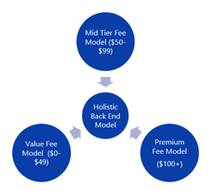
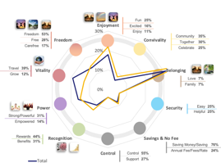
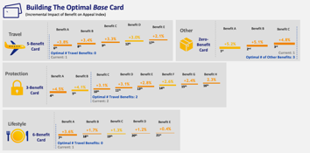
Case – Portfolio Optimization
Optimizing A Broad Line
Going Beyond Rationale to Assess Emotional Impact
Simplifying 10,000+ Scenarios to Actionable Insights
A leading credit card issuer wanted to revamp their entire benefit suite (over 100 benefits) across 3 annual fee tiers of credit cards. Ipsos recommended an unique approach which split benefits into 3 DCMs, with overlapping benefits from the closest tier featured in all models, Consumers were filtered to one DCM based on their current CC fee paid (if any) and what their future intention was for paying a fee for better benefits in the future. The results of this exercise were combined on the back end with our in-house marketing scientist to create a holistic model for the client.
Many companies simply take a rational approach to credit cards, but many benefits offered implicit emotional impacts that drive passion and a high degree of wanting for a credit card. Ipsos recognizes this cognitive challenge with consumers and deployed its proprietary Censydiam Metaphors exercise which uses image association and text analytics to analyze how connected consumers are to the card offer benefits and the implicit communication to guide MarComm recommendations. Each core card offer elicited different emotions vs. the average which helped this client better focus advertising on the core emotions that appealed to each tier.
The final output combined all three DCM exercises into one holistic model, using Ipsos Vantis proprietary forecast model to adjust stated preference for benefits (which is often overstated) to present results that are closer to real. The client used this analysis to drive recommendations with internal stakeholders and negotiate with partners on which benefits should be offered by payment tier along with messaging recommendations of how to best communicate these offers to drive adoption with consumers.

